Slide 1
SS ZG515 - Data Warehousing
Dr. Yashvardhan Sharma
CSIS Dept., BITS-Pilani

Slide 2
Need for Data Warehousing
Companies, over the years, gathered huge volumes of data
“Hidden Treasure”
Can this data be used in any way?
Can we analyze this data to get any competitive advantage?
If yes, what kind of advantage?

Slide 3
Benefits of Data Warehousing
Allows “efficient” analysis of data
Competitive Advantage
Analysis aids strategic decision making
Increased productivity of decision makers
Potential high ROI
Classic example: Diaper and Beer

Slide 4
Decision Support Systems, DW, & OLAP
Information technology to help the knowledge worker (executive, manager, analyst) make faster and better decisions.
Data Warehouse is a DSS
A data warehouse is an architectural construct of an information system that provides users with current and historical decision support information that is hard to access or present in traditional operational systems.
Data Warehouse is not an Intelligent system
On-Line Analytical Processing (OLAP) is an element of DSS

Slide 5
DW: Interesting Statistics

Slide 6
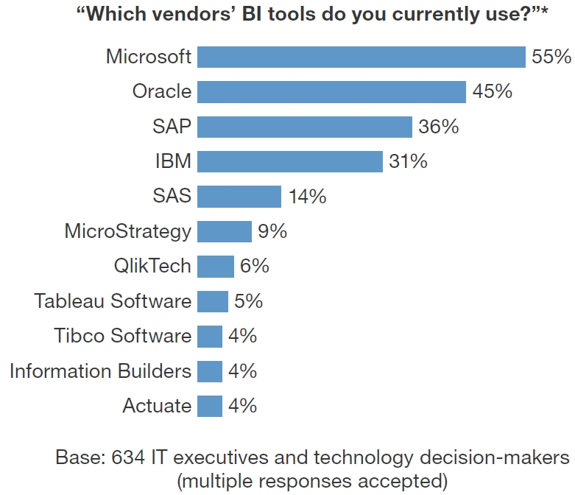

Slide 7
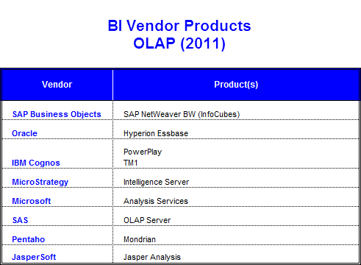
Data Warehouse: Major Players

Slide 8
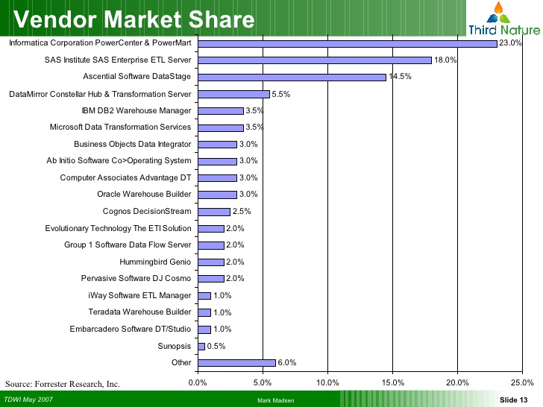

Slide 9
Data Warehouse: Characteristics
Analysis driven
Ad-hoc queries
Complex queries
Used by top managers
Based on Dimensional Modeling
Denormalized structures

Slide 10
Data Warehouse
A decision support database that is maintained separately from the organization’s operational databases.
”Data warehousing is a collection of decision support technologies, aimed at enabling the knowledge worker (executive, manager, analyst) to make better and faster decisions.”
A data warehouse is a
subject-oriented,
integrated,
time-varying,
non-volatile
“collection of data that is used primarily in organizational decision making” -Bill Inmon

Slide 11
R. Kimball’s definition of a DW
A data warehouse is a copy of transactional data specifically structured for querying and analysis.
According to this definition:
The form of the stored data (RDBMS, flat file) has nothing to do with whether something is a data warehouse.
Data warehousing is not necessarily for the needs of "decision makers" or used in the process of decision making.

Slide 12
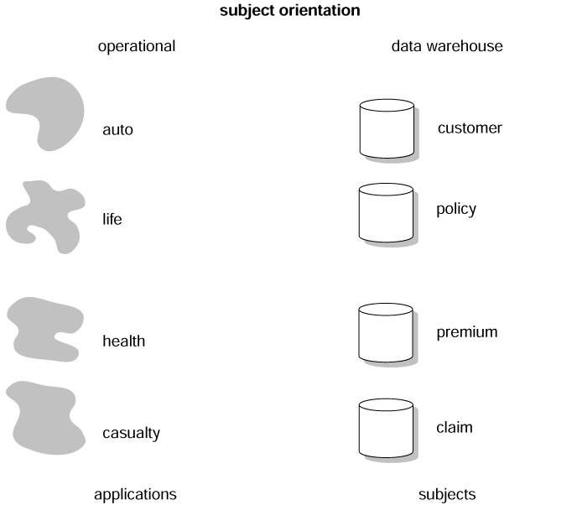
Subject-Oriented Data Collections
Classical operations systems are organized around the functional applications of the company.
For an insurance company, the applications may be auto, health, life, and casualty. The major subject areas of the insurance corporation might be customer, policy, premium, and claim.
For a manufacturer, the major subject areas might be product, order, vendor, bill of material, and raw goods.
For a retailer, the major subject areas may be product, SKU, sale, vendor, and so forth.
Each type of company has its own unique set of subjects

Slide 13
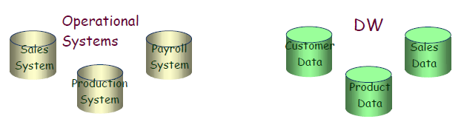
Data Warehouse — Subject-Oriented
Organized around major subjects, such as customer, product, sales.
Focusing on the modeling and analysis of data for decision makers, not on daily operations or transaction processing.
Provide a simple and concise view around particular subject issues by excluding data that are not useful in the decision support process.

Slide 14
Subject Oriented
Data Warehouse is designed around “subjects” rather than processes
A company may have
Retail Sales System
Outlet Sales System
Catalog Sales System
DW will have a Sales Subject Area

Slide 15
Subject Oriented
OLTP Systems
Data Warehouse
on
Retail Sales System
Outlet Sales
System
Catalog Sales
System
Sales Subject Area
Subject-Oriented Sales Information

Slide 16
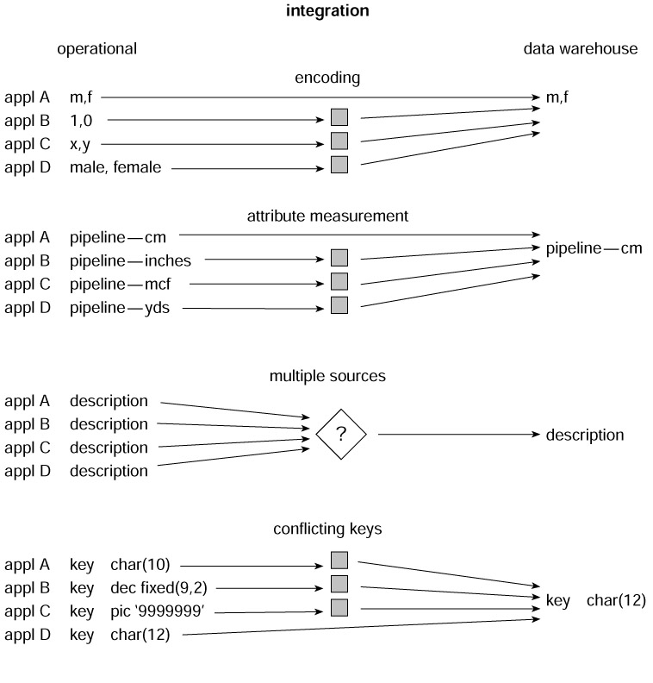
Integrated Data Collections
Of all the aspects of a data warehouse, integration is the most important. Data is fed from multiple disparate sources into the data warehouse. As the data is fed it is converted, reformatted,resequenced, summarized, and so forth. The result is that data—once it resides in the data warehouse—has a single physical corporate image.

Slide 17
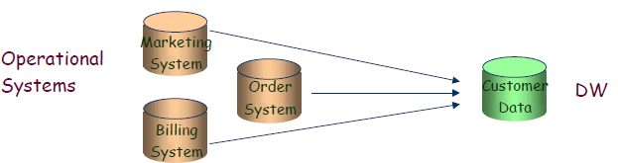
Data Warehouse — Integrated
Constructed by integrating multiple, heterogeneous data sources ––– relational or other databases, flat files, external data
Data cleaning and data integration techniques are applied. ––– Ensure consistency in naming conventions, encoding structures, attribute measures, etc. among different data sources ––– When data is moved to the warehouse, it is converted.

Slide 18
Integrated
Heterogeneous Source Systems
Little or no control
Need to Integrate source data
For Example: Product codes could be different in different systems
Arrive at common code in DW

Slide 19
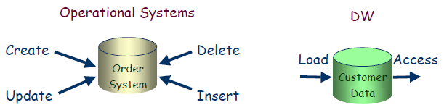
Data Warehouse — Non-Volatile
A physically separate store of data transformed from the operational environment.
Operational update of data does not occur in the data warehouse environment.
– Does not require transaction processing, recovery, and concurrency control mechanisms
– Requires only : loading and access of data.

Slide 20
Non-Volatile (Read-Mostly)
Write
USER
Read
Read
USER
OLTP
DW

Slide 21
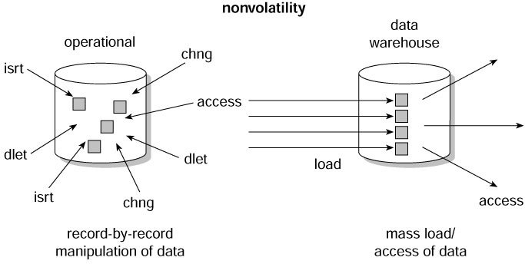
Non-volatile Data Collections
Data is updated in the operational environment as a regular matter of course, but warehouse data exhibits a very different set of characteristics. Data warehouse data is loaded and accessed, but it is not updated (in the general sense). Instead, when data in the data warehouse is loaded, it is loaded in a snapshot, static format. When subsequent changes occur, a new snapshot record is written. In doing so a history of data is kept in the data warehouse.

Slide 22
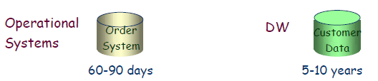
Data Warehouse — Time Variant
The time horizon for the data warehouse is significantly longer than that of operational systems.
– Operational database: current value data.
– Data warehouse data: provide information from a historical perspective (e.g., past 5-10 years)
Every key structure in the data warehouse
– Contains an element of time
– But the key of operational data may or may not contain “time element”.

Slide 23
Time Variant
Most business analysis has a time component
Trend Analysis (historical data is required)
Sales
2001 2002 2003 2004

Slide 24
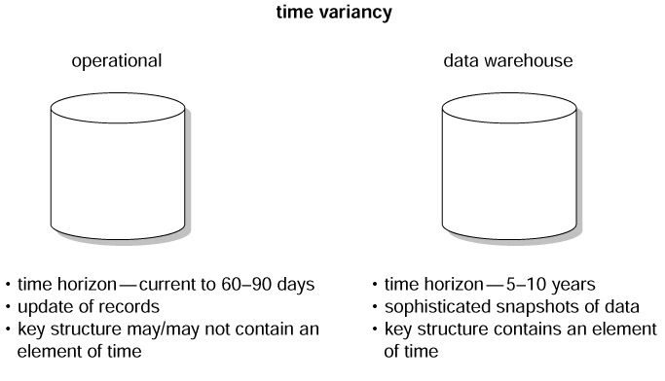
Time-variant Data Collections
Time variancy implies that every unit of data in the data warehouse is accurate as of some one moment in time. In some cases, a record is time stamped. In other cases, a record has a date of transaction. But in every case, there is some form of time marking to show the moment in time during which the record is accurate. A 60-to-90-day time horizon is normal for operational systems; a 5-to-10-year time horizon is normal for the data warehouse. As a result of this difference in time horizons, the data warehouse contains much more history than any other environment.

Slide 25
The goals of a Data Warehouse
The data warehouse must make an organization's information easily accessible.
The data warehouse must present the organization's information consistently.
The data warehouse must be adaptive and resilient to change.
The data warehouse must be a secure bastion that protects our information assets.
The data warehouse must serve as the foundation for improved decision making.
The business community must accept the data warehouse if it is to be deemed successful.

Slide 26
Data Warehouse Usage
Three kinds of data warehouse applications
Information processing
• supports querying, basic statistical analysis, and reporting using
crosstabs, tables, charts and graphs
Analytical processing
• multidimensional analysis of data warehouse data
• supports basic OLAP operations (slice-dice, drilling, pivoting, etc)
Data mining
• knowledge discovery from hidden patterns
• supports associations, constructing analytical models, performing
classification and prediction, and presenting the mining results using
visualization tools

Slide 27
 Problems with Data Warehousing
Underestimation of resources for data loading
Hidden problems with source systems
Required data not captured
Increased end-user demands
Data homogenization
High demand for resources
Data ownership
High maintenance
Long-duration projects
Complexity of integration

Slide 28
Loading the Data Warehouse
Data is periodically extracted
Data is cleansed and transformed
Users query the data warehouse
Source Systems
Data Staging Area
Data Warehouse
(OLTP)

Slide 29
Data Warehousing Architecture
Monitoring & Administration
OLAP servers
Metadata Repository
Analysis
Query/ Reporting
Data Mining
Data
Warehouse
External Sources
Extract
Transform
Load
Refresh
Serve
Operational dbs
Data Marts

Slide 30
Data Warehousing Architecture

